Slide 1
Detecting if a Twitter profile is BOT or NOT
Shivaraj Nesaragi
Fiona Marie Sequeira

Slide 2
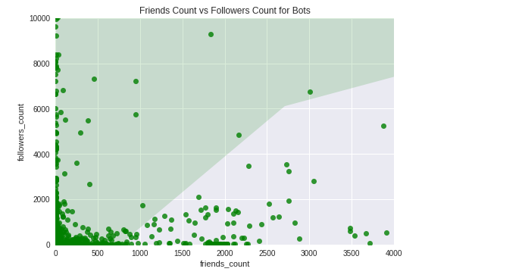
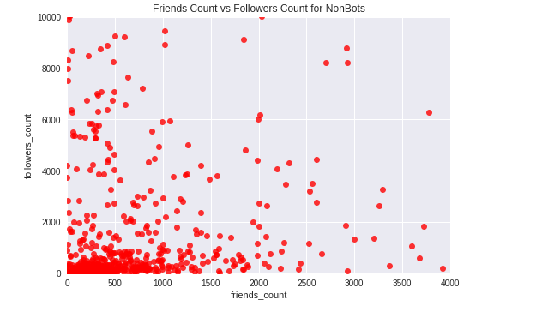
Overview of The Problem
Over the years Twitter has gained popularity in social media because of its openness which allows anyone to post in Twitter, as a result of which many bots have gained access to post any content.
Bots are typically software applications that run on scripts which efficiently fetch, analyze large data at speeds incomprehensible to humans. On social media platforms such as Twitter, bots have gained a lot more liberty to disguise themselves and easily be camouflaged. While bots can be useful source of information, a majority contribute to spam and nuisance over Twitter.
The purpose of our ML project is to identify Twitter bot profiles, based on specific identifying features. For this we make use of various machine learning algorithms such as Random Forest, XGBoost Classifier on a training data of numerous Twitter bot and human profiles, such that out and train the model to get the required output with maximum possible accuracy.
Scatterplot of features ‘followers_count’ vs ‘friends_count’ for Bot and Not Bot profiles

Slide 3
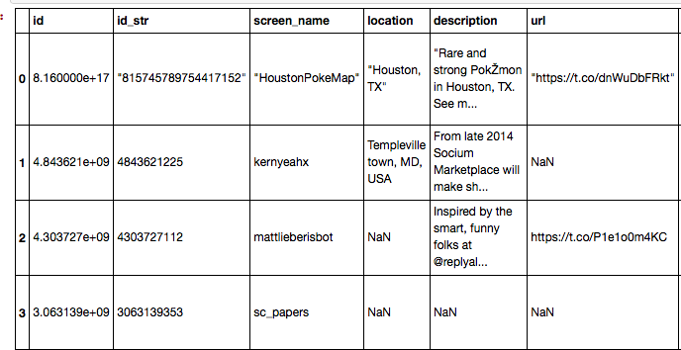
Overview of the Data Sets
In this project, we initially collected 50 twitter bot and 50 non-bot profiles by hand labelling the profiles. The final dataset on which our model is trained is a collection of shuffled profiles from all the student teams. The data collected had 20 attributes (the last attribute being Bot). The Bot attribute was set to 1 if the twitter profile was bot and 0 if the profile was a non-bot user. The dataset consists of numerical, categorical and text data varying from id, screen_name, status_count, followers_count to created_at etc.
The initial dataset is then divided into training and test data and each of the algorithms is run on that dataset. The dataset was filtered out in the initial stages since some of the attributes doesn’t make any sense to be included in the dataset, those include id and id str. Including these in the dataset will only lead to overfitting of the model and the performance of the model decreases accordingly.
Figure: A subset of the training data

Slide 4
Preprocessing of Data
Check for missing values NaN or None values for categorical or numeric fields in specific, and replace them with 0 or -1
Deal with categorical variables, such as True/False.
Handle textual data so that the classifiers we intend to use can be catered to. Examples:
- is_bot_location, checks for NaN or NULL values - is_bot_screename looks for the keyword bot, if its present it appends the length of the screen name to the new column else it appends a 0.
- is_bot description looks for the keyword bot, if its present it appends the length of the screen name to the new column else it appends a 0.
- is_bot_name looks for the keyword bot, if its present it appends the length of the screen name to the new column else it appends a 0. - age_of_profile computes the age of Twitter profile by calculating the difference from the current day to the date it was created in days. It uses the datetime library function.
- is_bot_url appends the length of the url to the user column, although its not a very prominent feature, we found that most bots don't have a url on an average, hence for those profiles that do have a url, the length is allocated, rest are left 0.

Slide 5
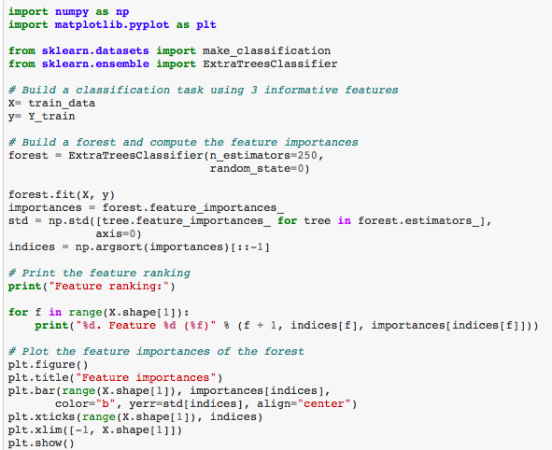
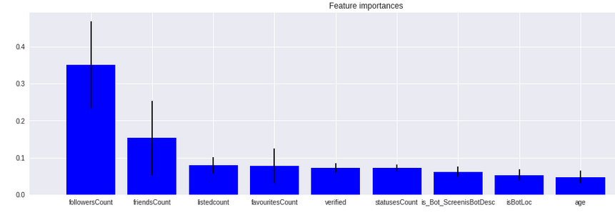
Analysis of Features
We filtered features such as id, id_str, default_profile_image, verified etc. which would not contribute to detecting if a profile belonged to a Bot or Not, since these features are more or less neutral and could not be biased for different users.
We used ExtraTreesClassifier to help us weigh out the importance of a collective features, which include the features mentioned in the previous slide. Most of the features that we have computed have been derived from textual or categorical fields alongside some features that were previously numeric.
These features are fitted to the ExtraTreesClassifier model and a bar graph is generated as we can see on the left. The age_of_profile , indexed 9, which is a computation of the days since a profile has been created ranks the top most and hence would be one of our most useful attributes.

Slide 6
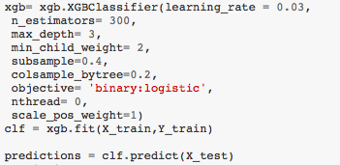
XGBoost Classifier
Once we have our training data and test data prepared. It’s now time to prepare our Classifier. Here we are using the eXtra Gradient Boosting Classifier, which is described as a constant addition and pruning or removal of decision trees in a sequence, alongside a constant attempt to rectify the mistakes a learner performed before it.
The XGBoost model for classification is called XGBClassifier. We can create and and fit it to our training data using the scikit-learn API and the model.fit() function. XGBoost uses regression trees as base learners by default.
Booster Parameters
min_child_weight [default=1], max_depth [default=6], subsample [default=1], colsample_bytree [default=1]
Learning Task Parameters
These parameters are used to define the optimization objective the metric to be calculated at each step.
objective [default=reg:linear],binary:logistic

Slide 7
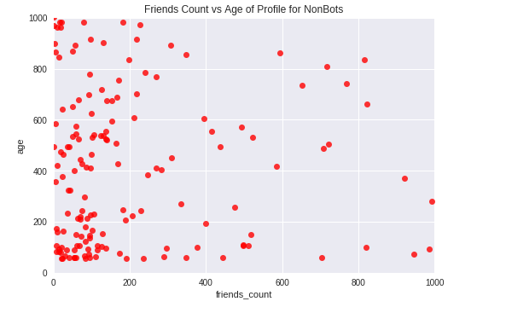
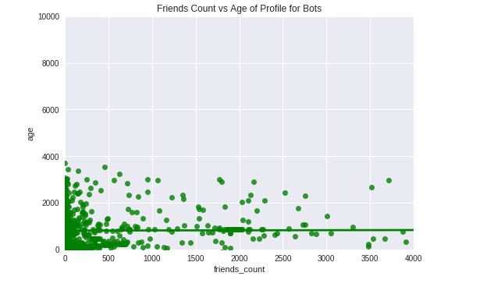
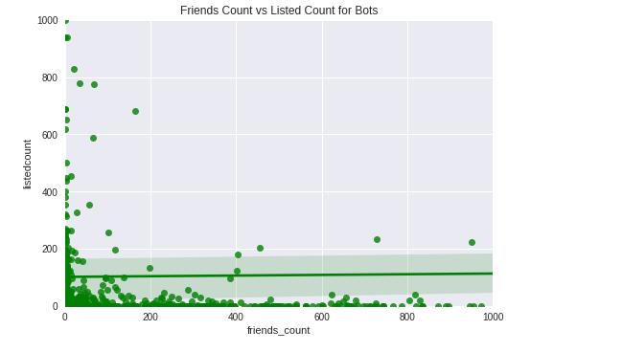
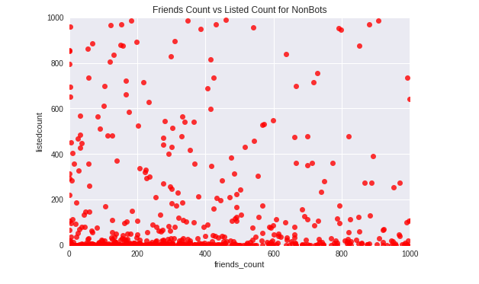

Slide 8
Conclusion
The results obtained from the algorithms predicted the class of the user as a bot or non-bot. The Random Forest algorithm gave an accuracy of 92% where as the XGBoost Classifier gave an accuracy of 93%.
We made use of more tuning parameters for Random Forest Classifier as well as XGBoost classifier. The XGBoost and Random Forest Classifier performed pretty well and we had good accuracy in predicting whether a profile was a bot or a non bot. We also came to know that different values for tuning parameters gave different accuracy and auc score. This led us to choose optimal values by executing the code numerous times.
We tried combination of the different values for these parameters and arrived at the optimal set of values which gave better accuracy on train test data split.
For XGBoost we used the tuning parameters such as learn- ing rate,n estimators,max depth,min depth,min child weight etc. These parameters were also tested for the optimal values and the set of values which gave better accuracy were chosen

Slide 9
Future Work
The things that didn’t go as expected was we were unable to parse the status column as it had inconsistency in its structure.
If we had more time we would definitely work on parsing this column and tokenizing the words using TFIDF or CountVectorizer and convert it into a numerical column and use it for training the model.
This might have helped us to achieve better accuracy. This would be our ethos.

